Slide 1
Ordering fractions by way of a common denominator
Comparing and ordering fractions and decimals (positive and negative)

Slide 2
how to use Oak lessons

Slide 3
I can compare and order fractions by converting to fractions with a common denominator.

Slide 4

Numerator − The expression in a fraction that is written above the fraction line. It is the dividend.
Denominator − The expression in a fraction that is written below the fraction line. It is the divisor.
numerator
denominator
The lowest common multiple is the lowest number that is a multiple of two or more numbers.

Slide 5

Ordering fractions by way of a common denominator
Review writing equivalent fractions
Comparing fractions
Order fractions using equivalent fractions

Slide 6
Review writing equivalent fractions
You are familiar with simplifying fractions using the highest common factor.
We can also create equivalent fractions using factors.
The most useful purpose for this is to create fractions which share a common denominator.

Slide 7
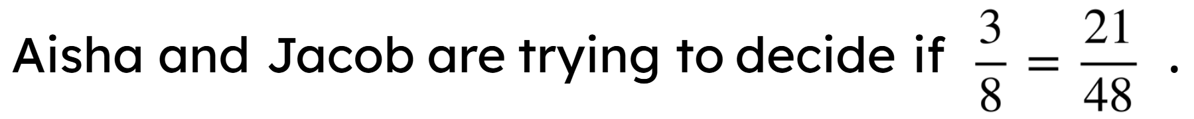
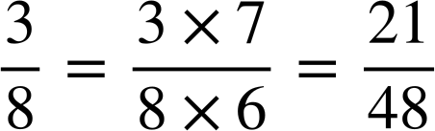
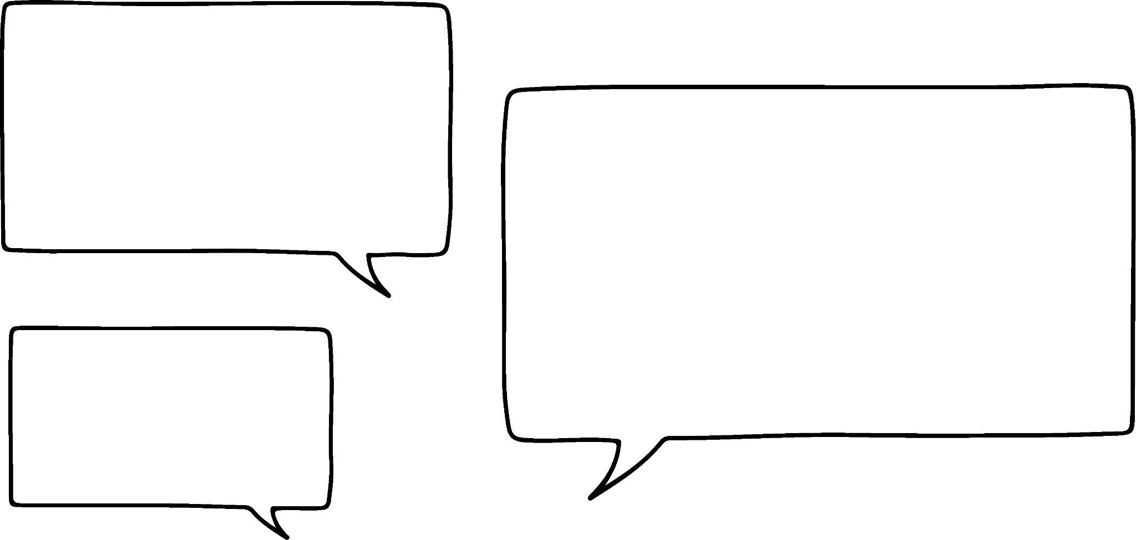


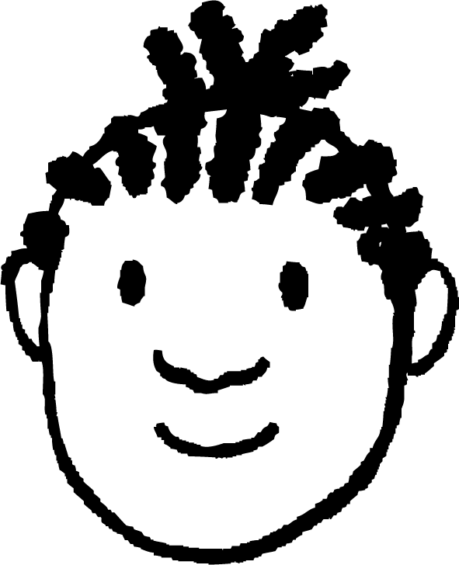
Review writing equivalent fractions
What do you think?
How could they check using factor pairs?
I agree. To be equivalent you have to multiply by one.
I don’t think they are equivalent.
Yes,
and
is not
equivalent to one.
Aisha
Jacob

Slide 8
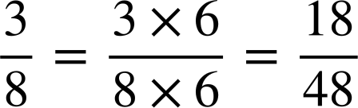
Review writing equivalent fractions
denominator of 48 what would the numerator be?
Remember this needs to be equivalent to one.
So as not to change the value of the original fraction.

Slide 9
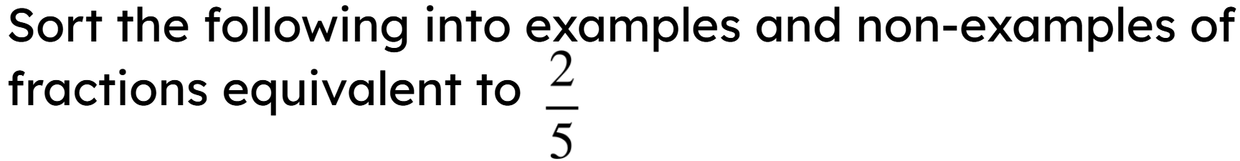
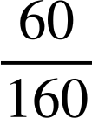
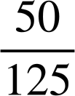






Review writing equivalent fractions
Examples
Non-examples

Slide 10
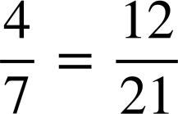

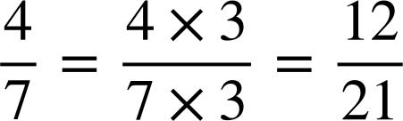
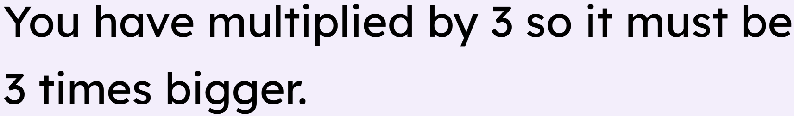
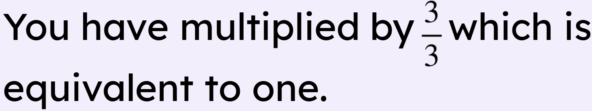
Review writing equivalent fractions

Slide 11
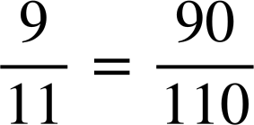
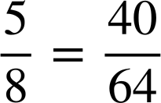
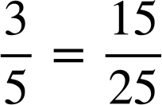
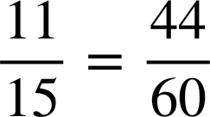
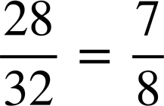
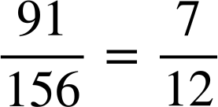
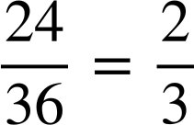
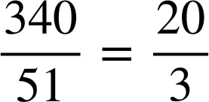
Review writing equivalent fractions
Fill in the missing numerator or denominator.
a)
e)
b)
f)
c)
g)
d)
h)

Slide 12
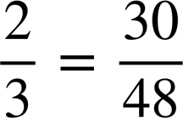
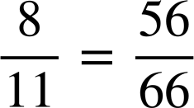
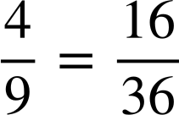
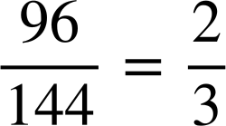
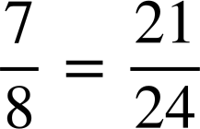
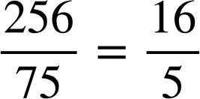
Review writing equivalent fractions
2) Which of the following are true?
a)
b)
c)
d)
e)
f)

Slide 13
Review writing equivalent fractions
Fill in the missing numerator or denominator.
a)
e)
b)
f)
c)
g)
d)
h)

Slide 14
Review writing equivalent fractions
2) Which of the following are true?
a)
b)
c)
× 15
× 16
False
d)
e)
f)
× 7
× 6
False
× 4
× 4
True
÷ 48
÷ 48
True
× 3
× 3
True
÷ 16
÷ 15
False

Slide 15
Ordering fractions by way of a common denominator
Review writing equivalent fractions
Comparing fractions
Order fractions using equivalent fractions

Slide 16

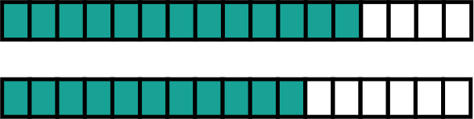
Comparing fractions
Which is greater?
<

Slide 17
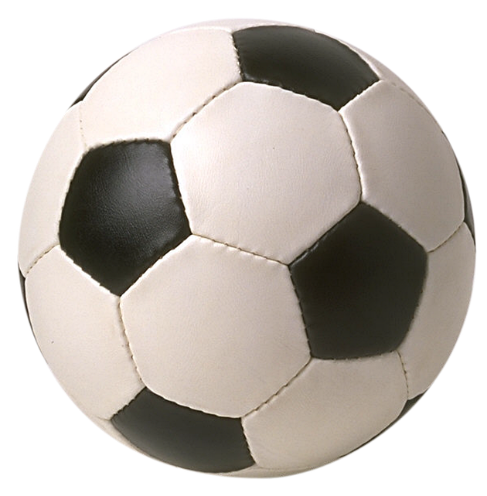
Comparing fractions
Aisha and Jacob love practising their penalty shooting skills.
They want to know who had the greatest success rate.
Unfortunately they did not shoot the same number of penalties.
We both got one more than a half so we had the same success rate.
I shot 8 penalties and scored 5.
I shot 12 and scored 7.
Aisha
Do you agree with Aisha?
Jacob

Slide 18
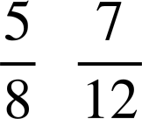
Comparing fractions
We will use our knowledge of equivalent fractions to see if this is true.
We need to find the lowest common multiple of 8 and 12.
This will allow us to create two fractions with a common denominator so that we can compare them.
I
score
of my shots.
score
of my shots.
I
Aisha
Jacob

Slide 19
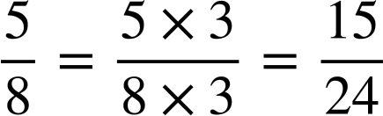
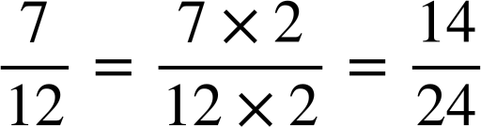
Comparing fractions
Multiples of 8:
8,
16,
24
The LCM of 8 and 12 is 24.
Multiples of 12
12,
24
I
score
of my shots.
score
of my shots.
I
Aisha had a better success rate.
How did we know that is true?
Aisha
Jacob
is larger than

Slide 20
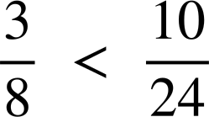
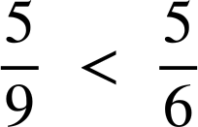
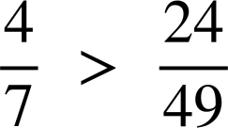
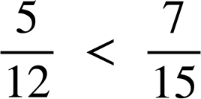


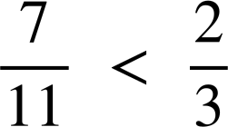
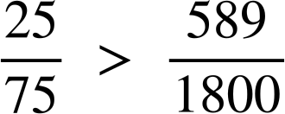
Comparing fractions
Use equivalent fractions to decide which fraction is greater.
Insert either < or > to make the statement true.
a)
e)
b)
f)
c)
g)
d)
h)

Slide 21



Comparing fractions
2)
Place the words ‘greater’ and ‘less’ in the sentence:
is
than
but
than
.
Is he correct?

Slide 22
Comparing fractions
Use equivalent fractions to decide which fraction is greater.
Insert either < or > to make the statement true.
a)
e)
b)
f)
c)
g)
d)
h)

Slide 23

Comparing fractions
2)
Place the words ‘greater’ and ‘less’ in the sentence:
less
greater
is
than
but
than
.
Is he correct?
Jacob is correct as there is between and , as well as between and .

Slide 24
Ordering fractions by way of a common denominator
Review writing equivalent fractions
Comparing fractions
Order fractions using equivalent fractions

Slide 25






Order fractions using equivalent fractions
Aisha, Lucas, Laura and Jacob have been practicing their basketball shooting skills.
Write them in order of performance.
I scored
of my shots.
I scored
of my shots.
I scored
of my shots.
I scored
of my shots.
Sofia
Aisha
Lucas
Jacob

Slide 26
Order fractions using equivalent fractions
Aisha
Lucas
Sofia
Jacob
We need to find the LCM of 12, 8, 16 and 24.
We will not list the multiples this time.
We can go through the multiples of 24 and consider if they are multiples of the other 3 numbers.

Slide 27
Order fractions using equivalent fractions
Aisha
Lucas
Sofia
Jacob
Start with 24
24 is not a multiple of 16. Therefore, we can move onto the next multiple of 24.

Slide 28
Order fractions using equivalent fractions
Aisha
Lucas
Sofia
Jacob
Now check 48
48 is a multiple of 16, 8 and 12, therefore this is the LCM of all 4 denominators.

Slide 29




Order fractions using equivalent fractions
Aisha
Lucas
Sofia
Jacob
The LCM of 12, 8, 16 and 24 is 48.
This will be our common denominator.

Slide 30
Order fractions using equivalent fractions
Aisha
Lucas
Sofia
Jacob
In order from most to least successful:
Lucas, Aisha, Sofia and Jacob

Slide 31




Order fractions using equivalent fractions
Using a common denominator, write these fractions in order from smallest to largest.
In order:

Slide 32




Order fractions using equivalent fractions
Write the following fractions with a common denominator and order from smallest to largest.
a)
b)
c)
d)

Slide 33




Order fractions using equivalent fractions
Write the following fractions with a common denominator and order from smallest to largest.
a)
b)
c)
d)

Slide 34
Ordering fractions by way of a common denominator
Any fraction can be written as an equivalent fraction by multiplication of 1. E.g.
Fractions can be ordered by converting to fractions with a common denominator.
The efficient way of doing this is by finding the LCM of the denominators.

Slide 35

© Oak National Academy 2023.
Produced in partnership with Mathematics in Education and Industry.
Licensed on the Open Government Licence v3.0, except where otherwise stated. See Oak terms and conditions.

